Slide 1

Approval of stabilization of similar images Software Engineering WS 18/19 Lecturer: Damir Dobric Professor: Prof. Dr. Andreas Pech
Anil Kumar Gupta
Matriculation number:1266270

Slide 2
Contents
Introduction
Spatial Pooler
Image Binarization
Hamming Distance
Methods
Trained data
Prediction
Result
Discussion
References

Slide 3
Introduction
Spatial Pooler : The spatial pooler takes the input data and translates the incoming data into active columns. Spatial pooling Algorithm is for solving problems to represent the input active neurons to make that the cortex learn the pattern of sequences.
ImageBinarizer: This nocortexAPI ImageBinarizer library is used to binarize the input images.Moreover, this tool only can give the output string to display to console window or as a text file into 0 and 1.
Hamming Distance: Hamming distance is a metric for comparing two binary data strings. While comparing two binary strings of equal length, Hamming distance is the number of bit positions in which the two bits are different.

Slide 4
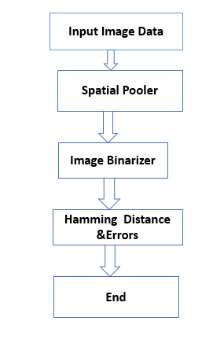
Implementation
Code explanation
Fig. Project Structure

Slide 5
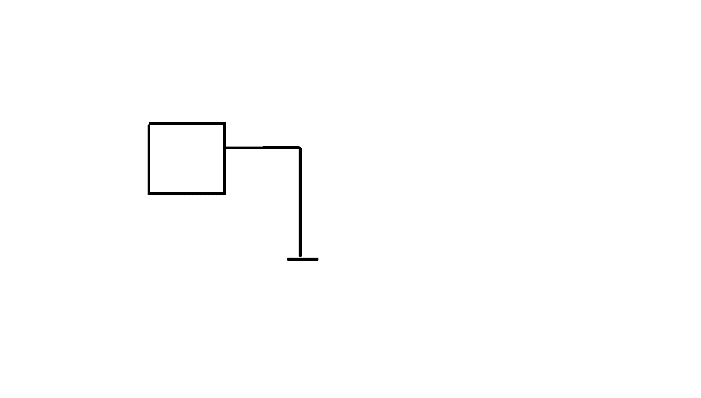
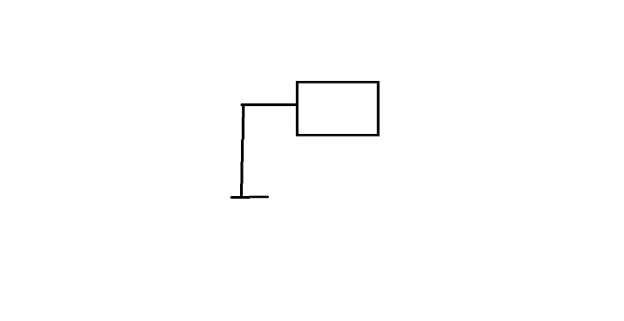
Input image
Fig. 1. lamp1
Fig. 2.lamp2

Slide 6
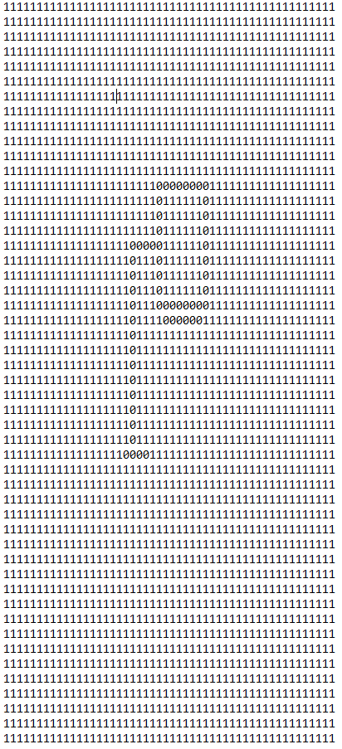
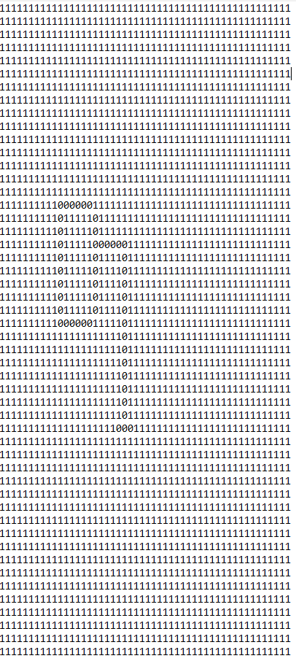
Results
Fig. Binarized image of lamp2
Fig. 4. Binarized image of lamp1

Slide 7
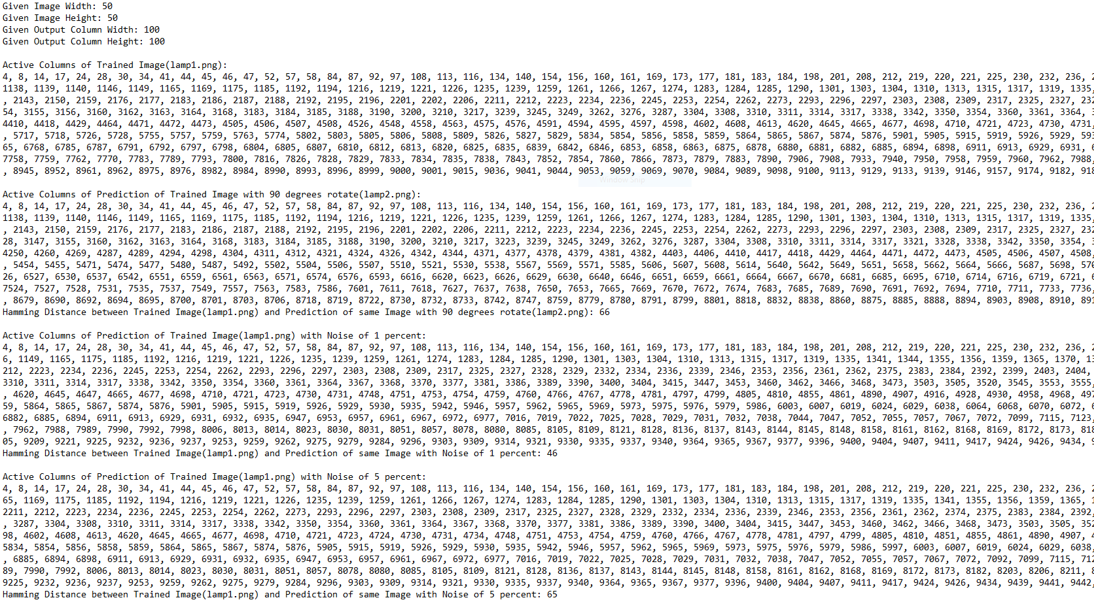

Slide 8
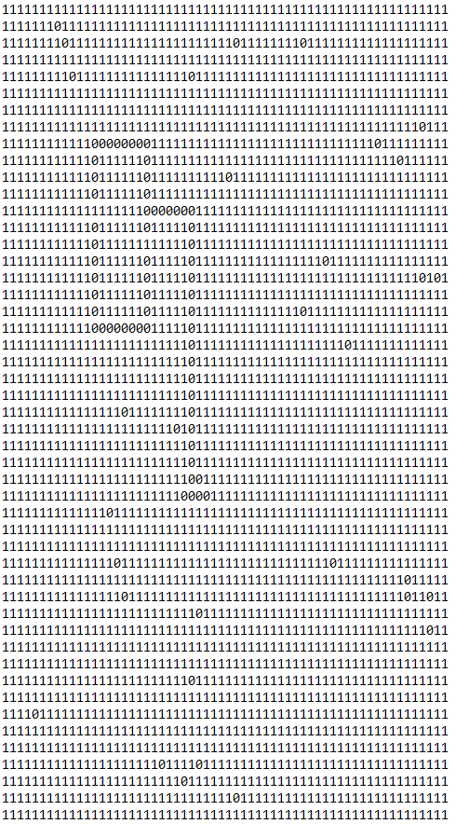
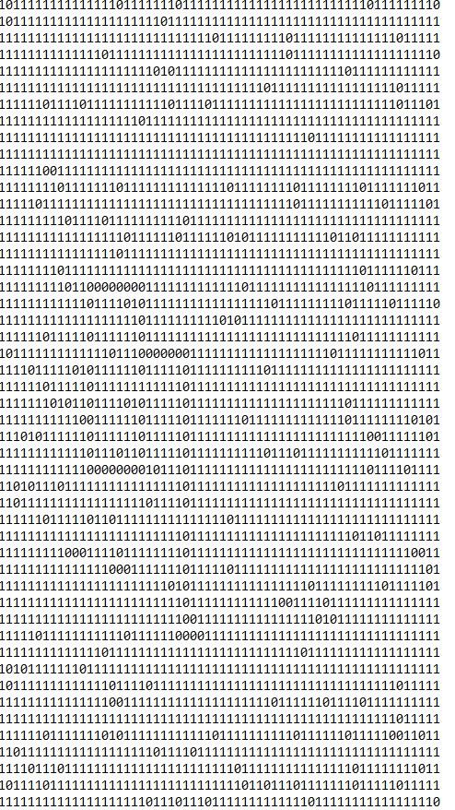
Fig.fish1 Binarized image with 1% error
Fig.fish1 Binarized image with 5% error

Slide 9
Thank you for your Attention!! Any Question please ?

